Slide 1


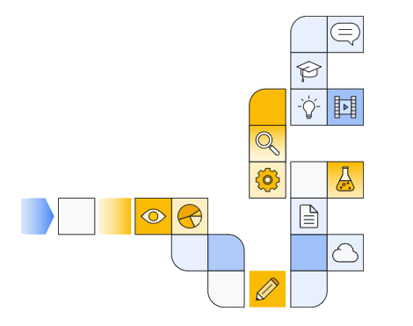

Notes:
https://www.cloudskillsboost.google/paths/183/course_templates/543

Slide 2
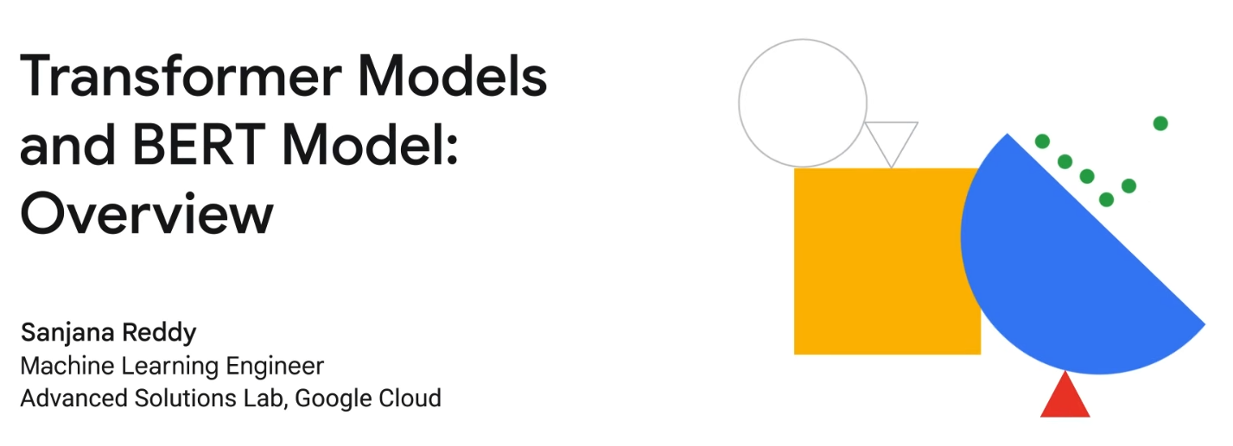

Two videos to watch?
Notes:
https://www.youtube.com/watch?v=sUCiDU8GhMA (old)
https://www.youtube.com/watch?v=hsp1OAcoLBY (new)

Slide 3
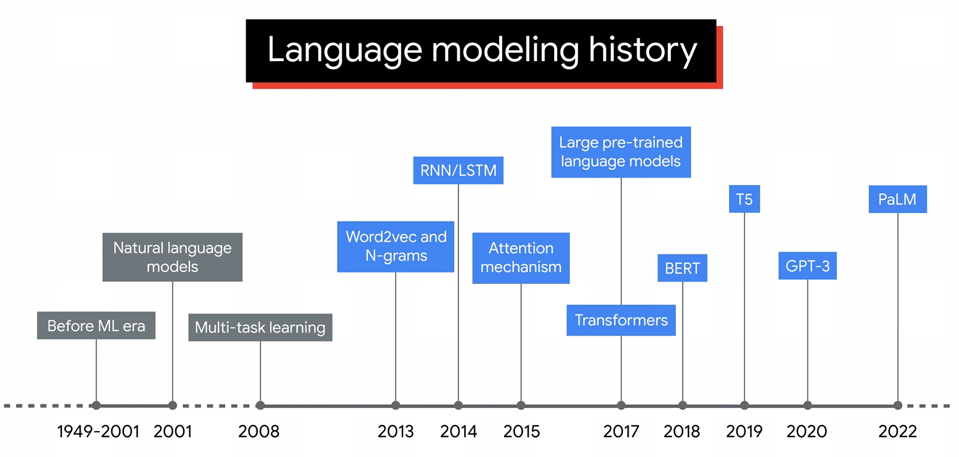

Slide 4
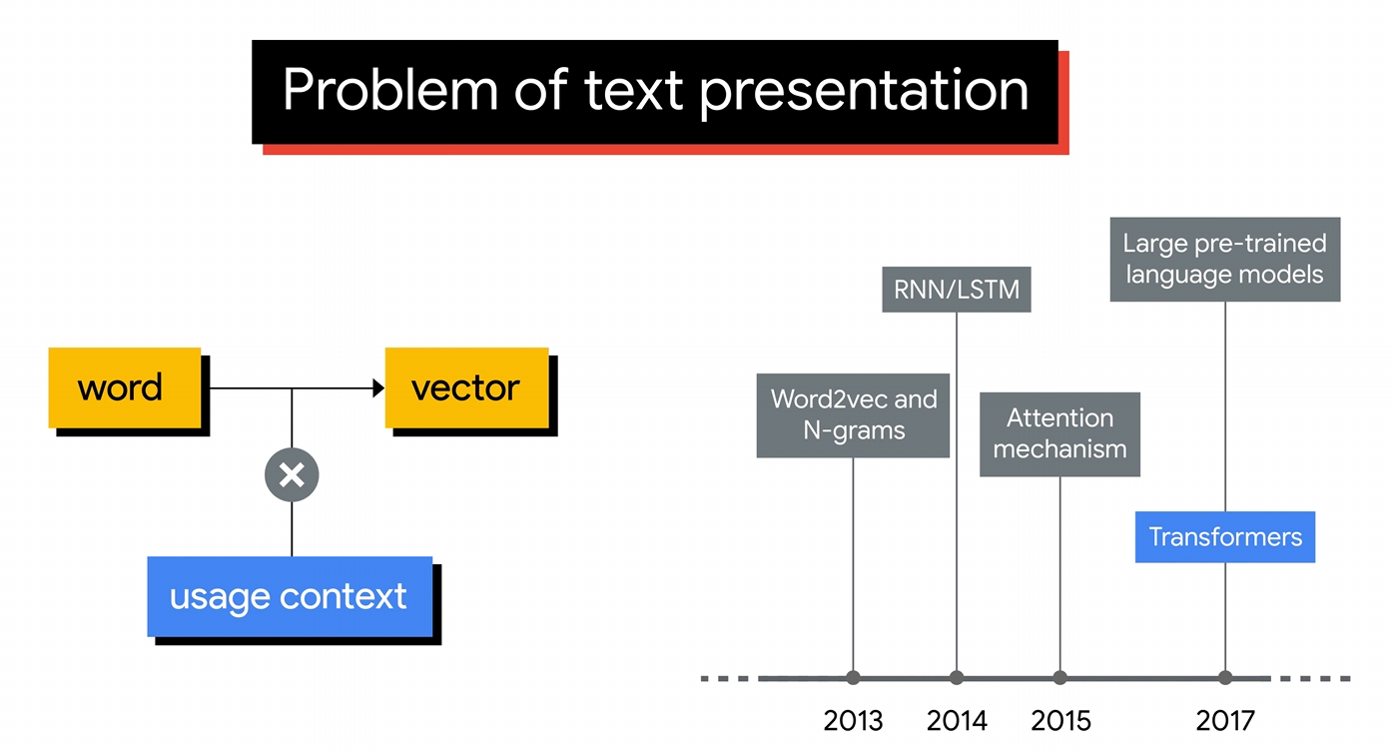
Before Transformers Came Along
Bank (Robber)
(River) Bank
1211
1211

Slide 5
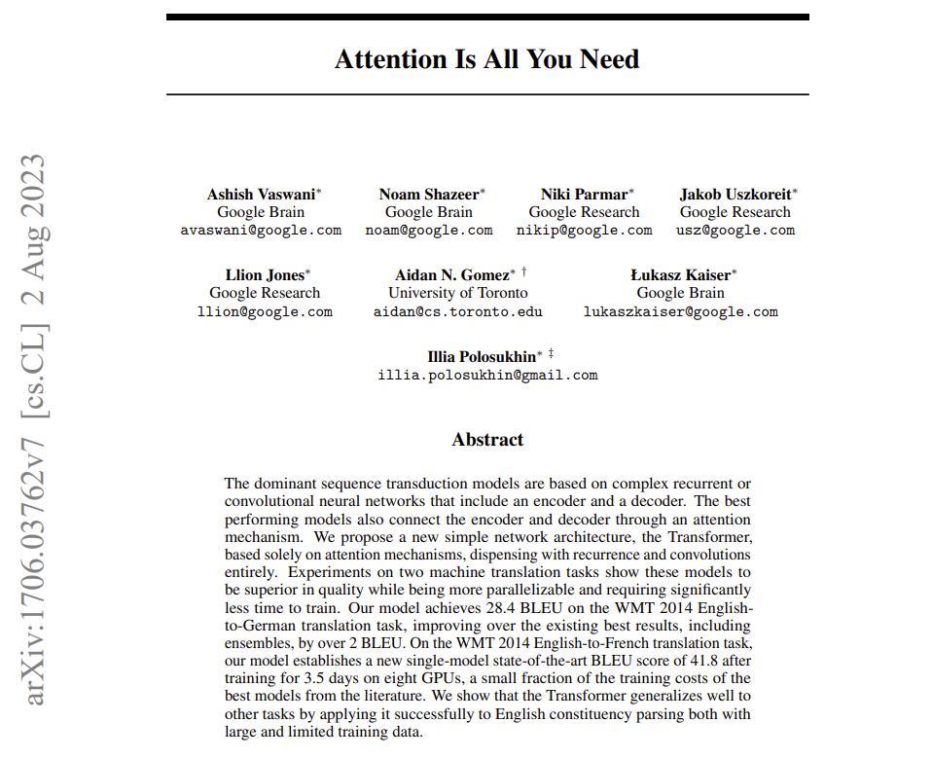
Notes:
https://arxiv.org/pdf/1706.03762

Slide 6
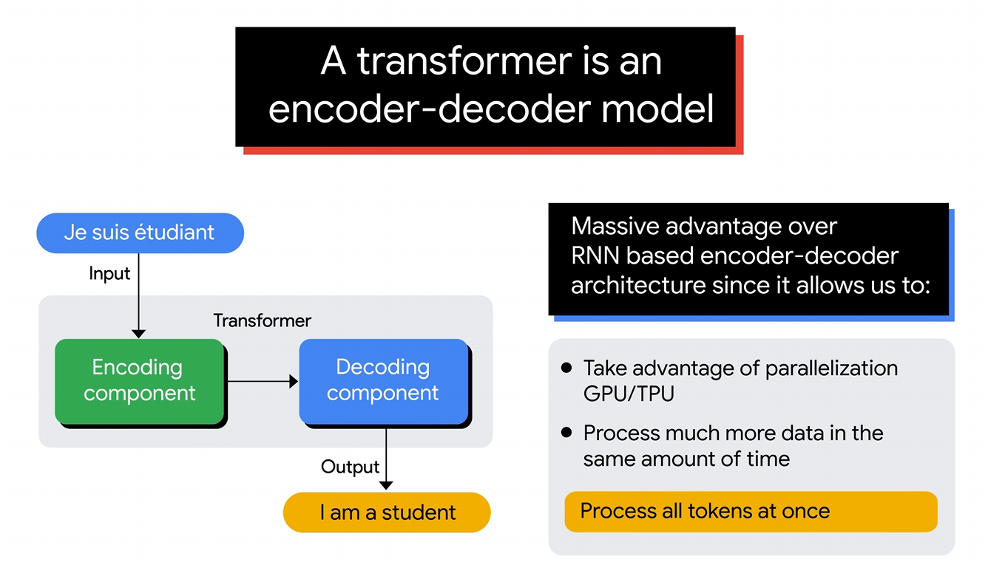

Slide 7
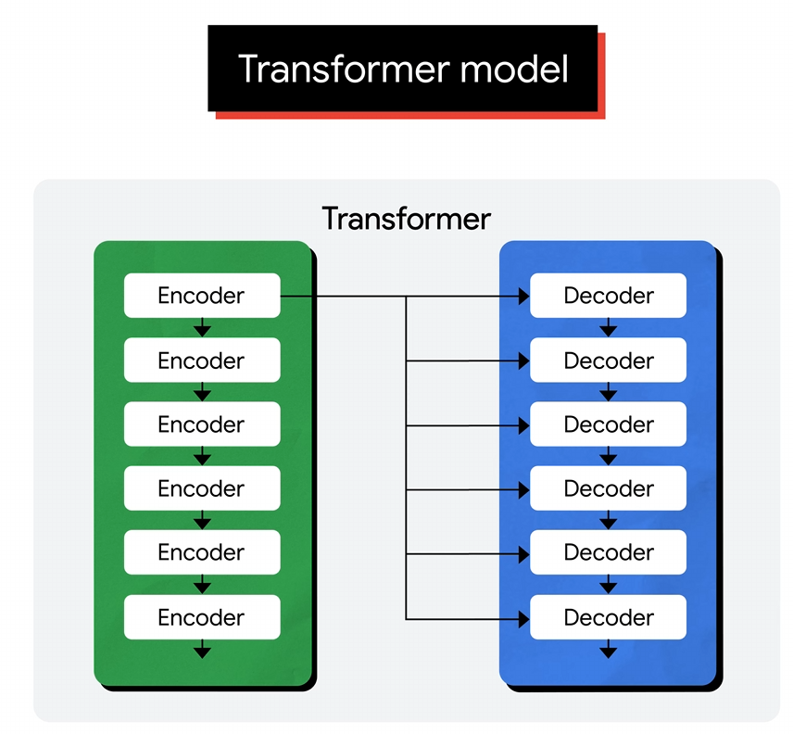
Hyperparameter determines how many encoders and decoders you have

Slide 8
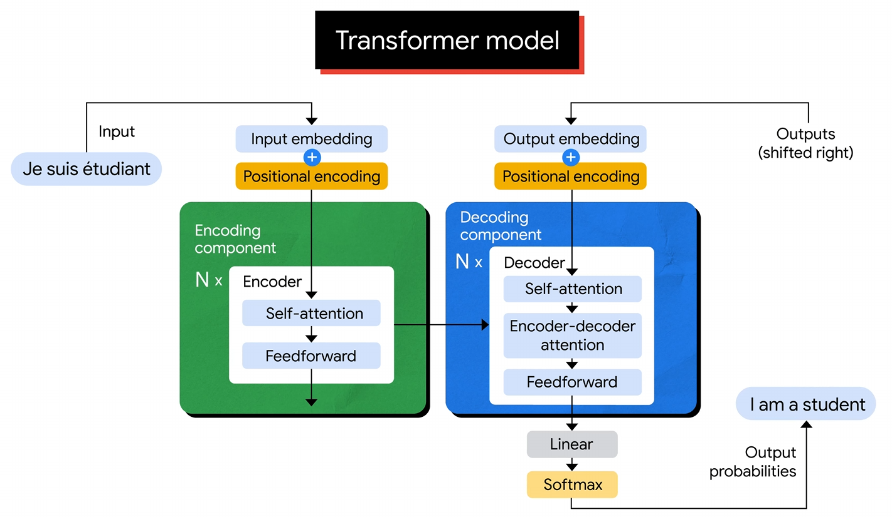
Built with attention mechanisms in the core architecture

Slide 9
Self-Attention

Slide 10
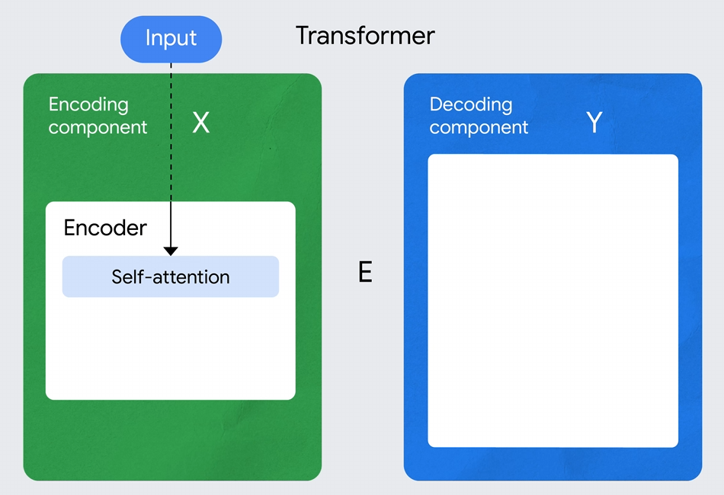
Contextual Understanding: Self-attention enables the model to capture dependencies between words, regardless of their distance in the sentence. For example, in the sentence "The cat sat on the mat, and it was soft," the word "it" refers to "mat," and self-attention helps the model make this connection.
Parallelization: Unlike RNNs, which process sequences one word at a time, self-attention allows for parallel computation, making Transformers much more efficient for training on large datasets.
Positional Encoding: Since self-attention doesn't inherently consider the order of words, Transformers use positional encoding to add information about the position of each word in the sequence.

Slide 11
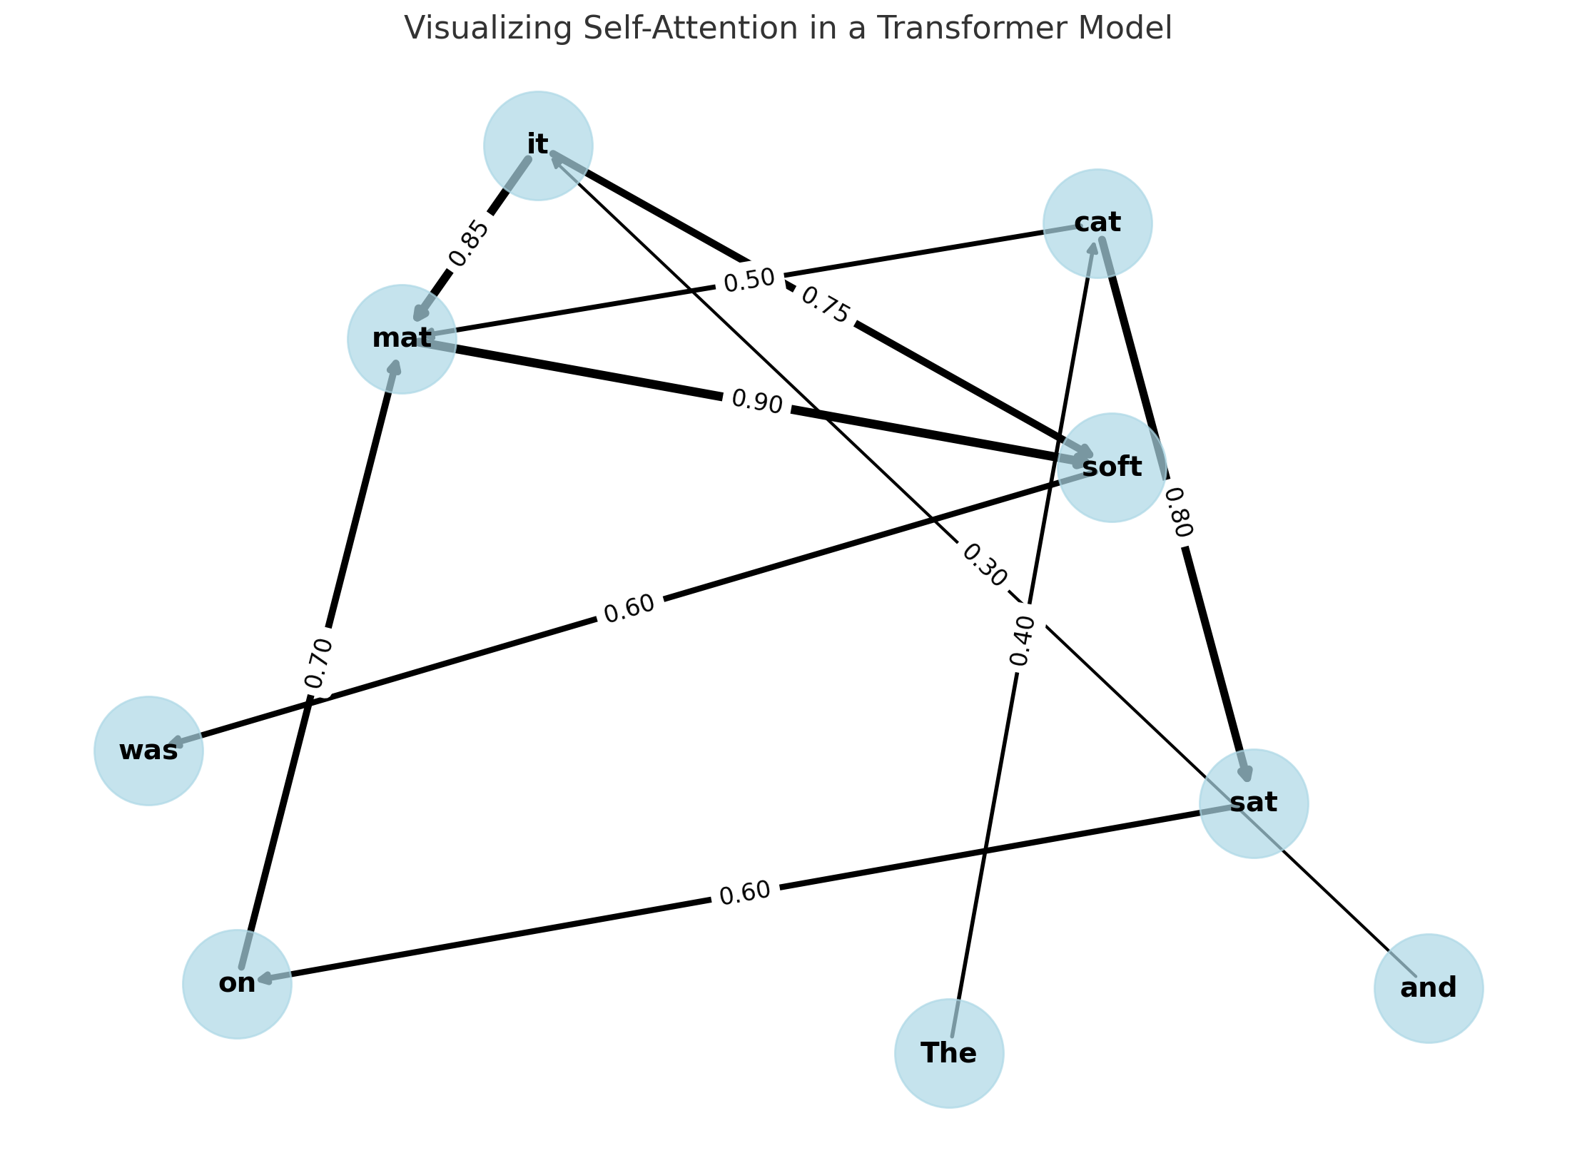

Self-attention example: “The cat sat on the mat, and it was soft”

Slide 12
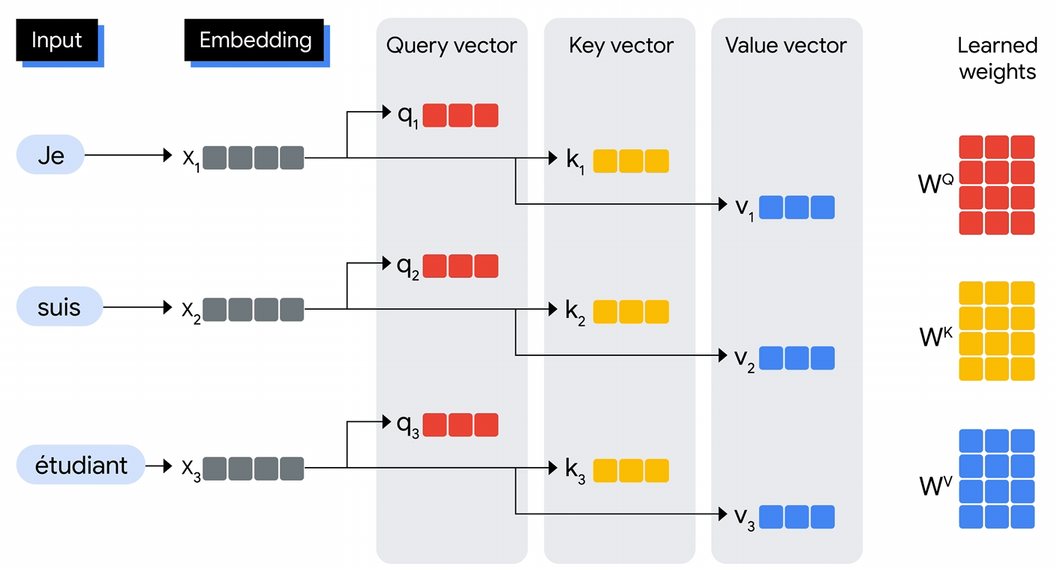

Slide 13
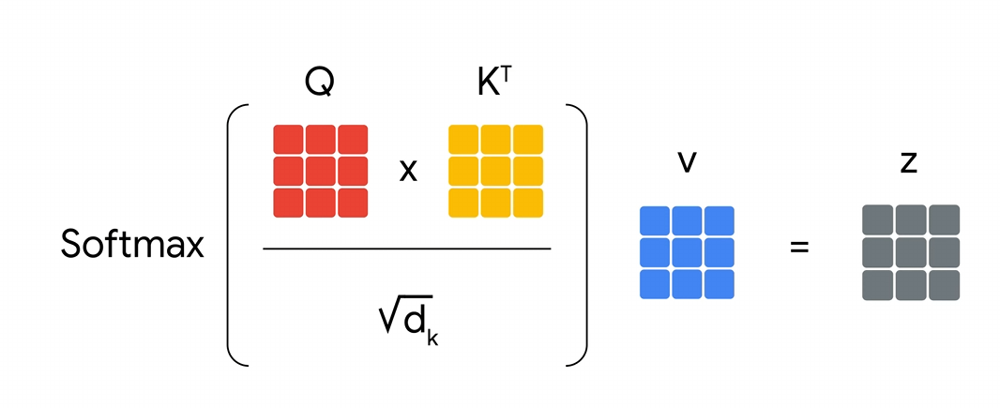

Slide 14
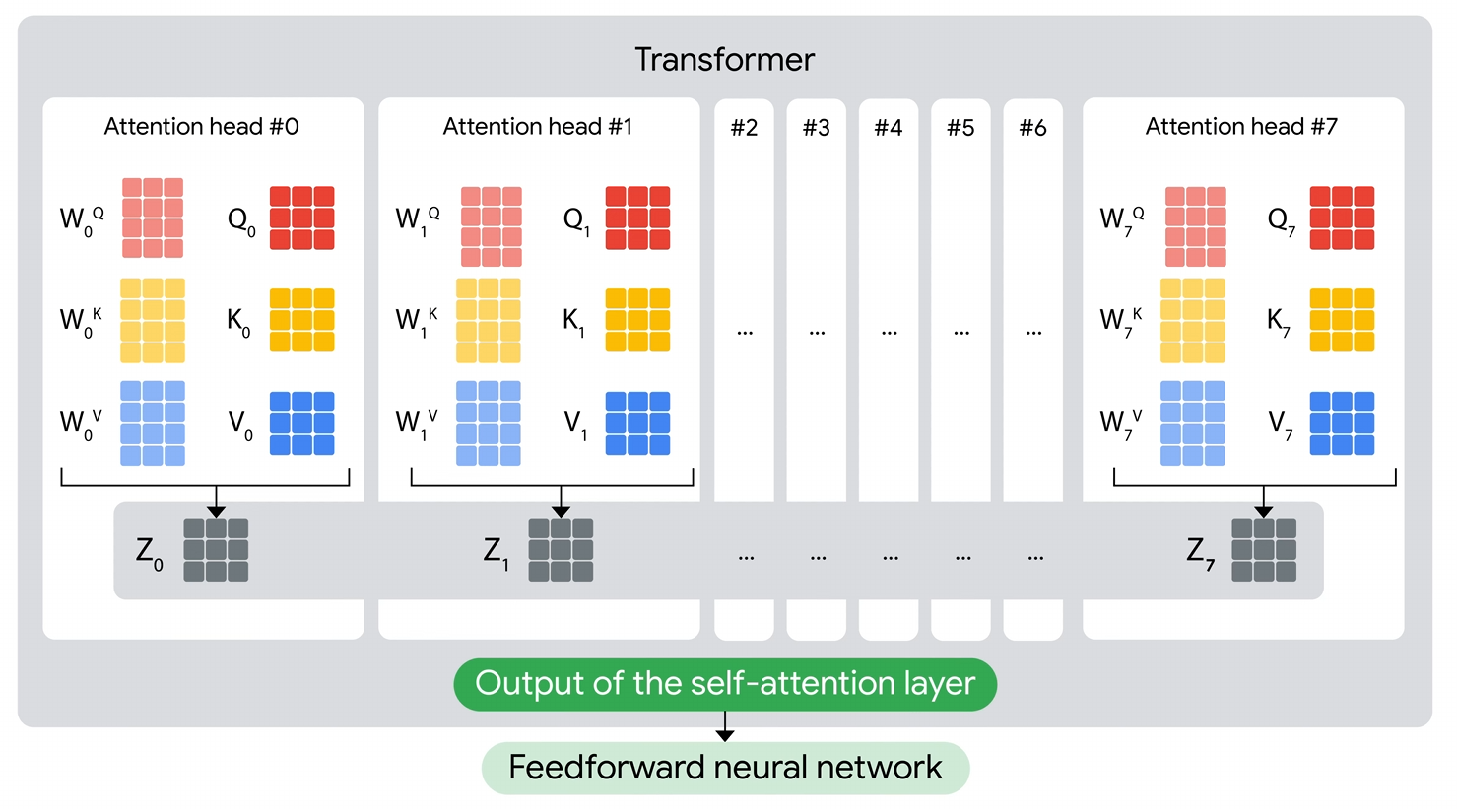

Slide 15
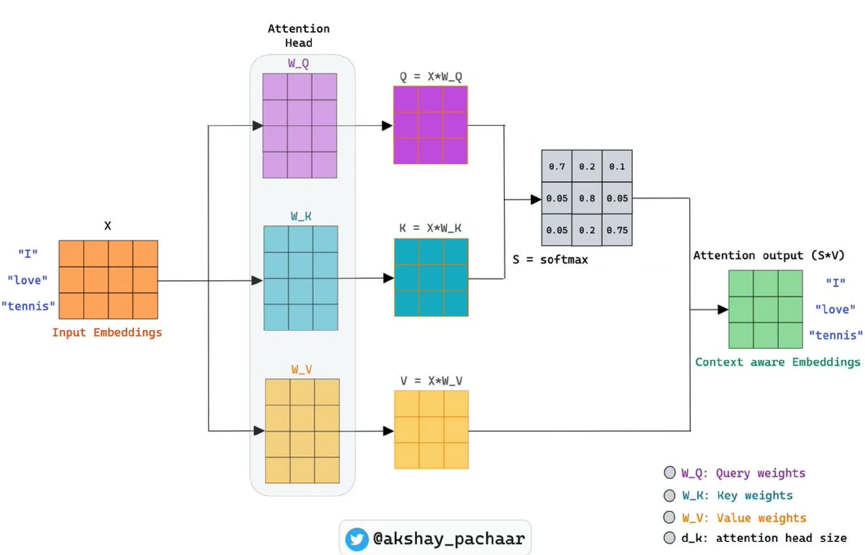
Training example
Notes:
https://2020machinelearning.medium.com/decoding-the-key-query-value-mechanism-in-transformer-models-thru-a-deep-discussion-with-claude-ai-2da5a66d4f8e

Slide 16
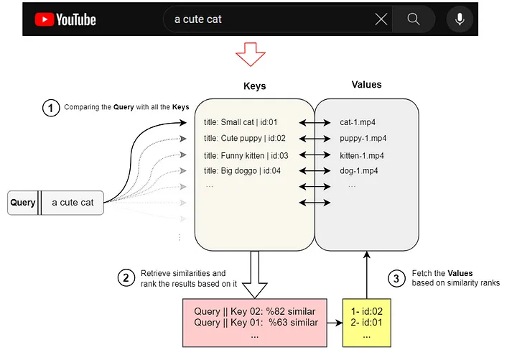
Inference example
Notes:
https://archive.is/sbg5t

Slide 17
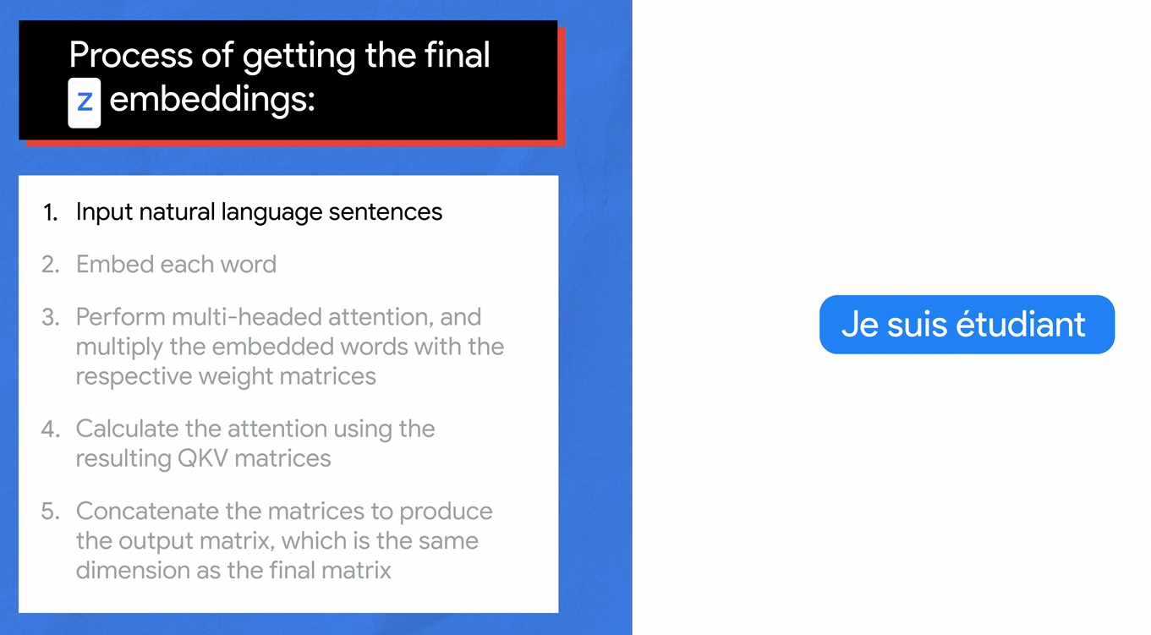

Slide 18
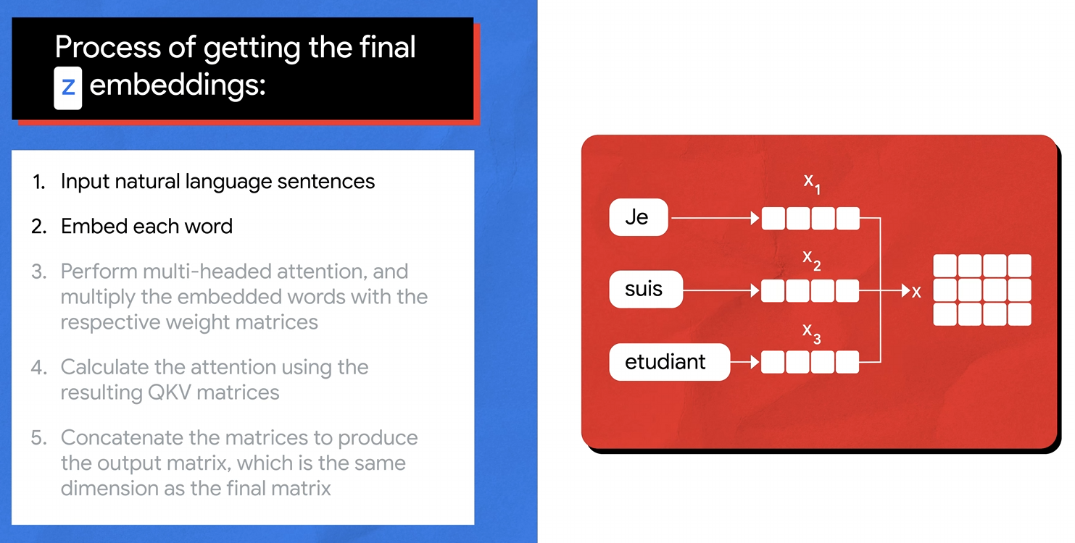

Slide 19
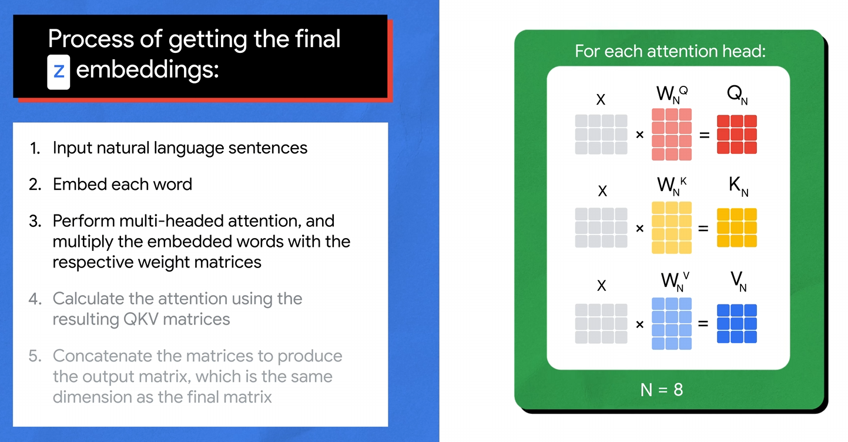

Slide 20
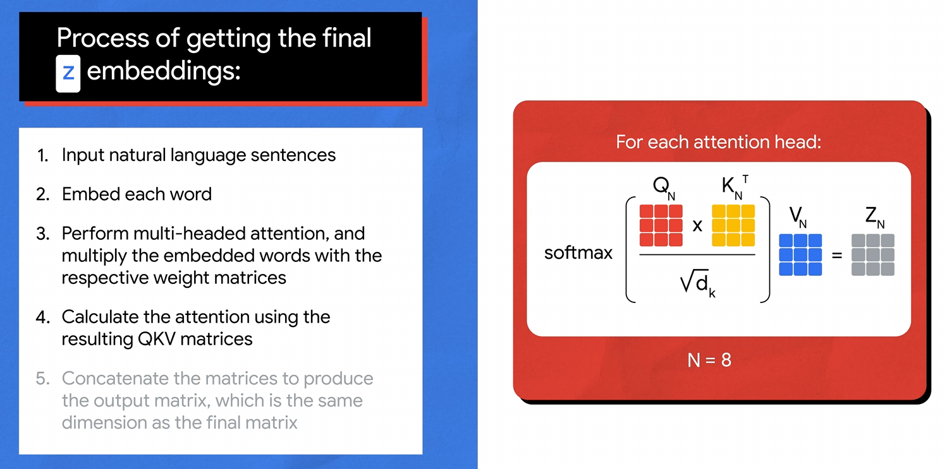

Slide 21
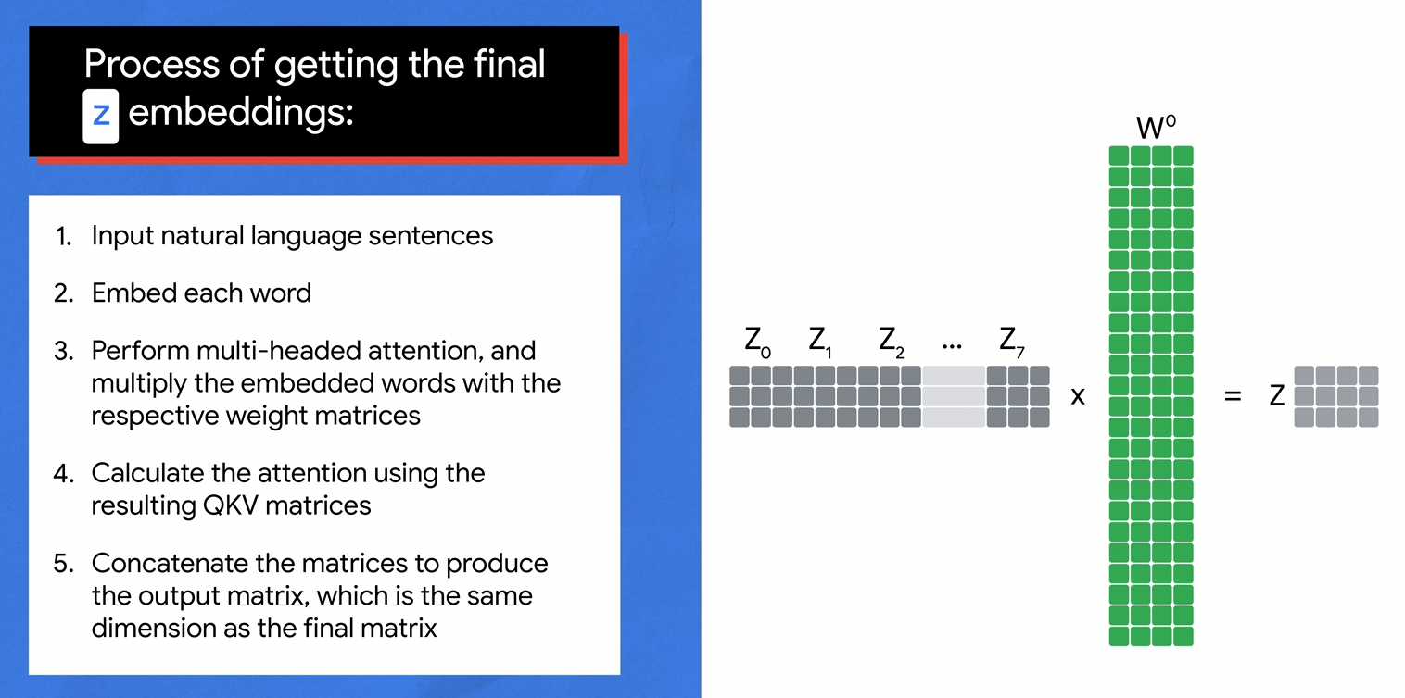

Slide 22
Feed Forward

Slide 23
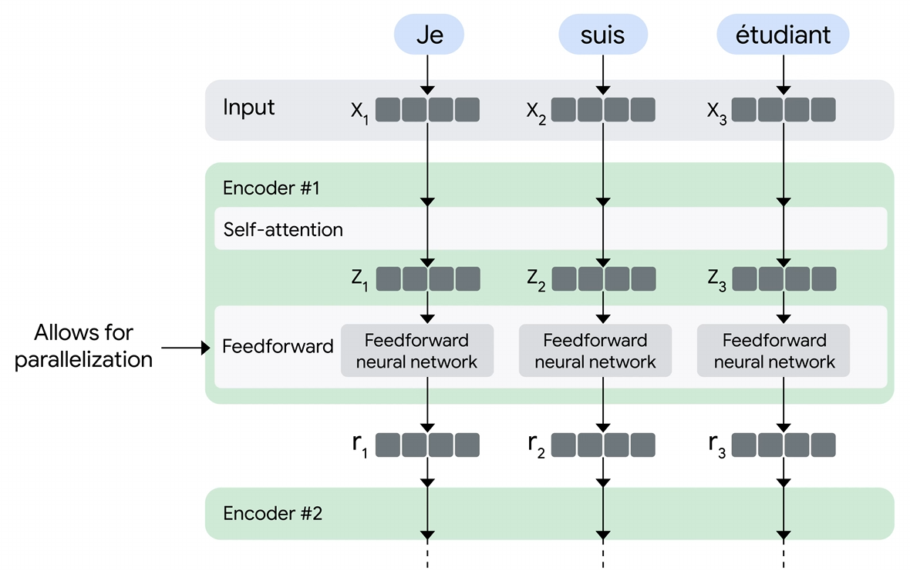

Slide 24
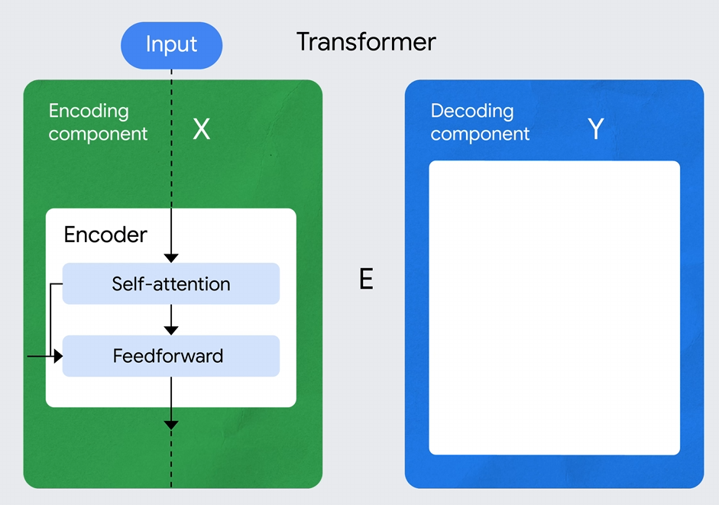

Slide 25
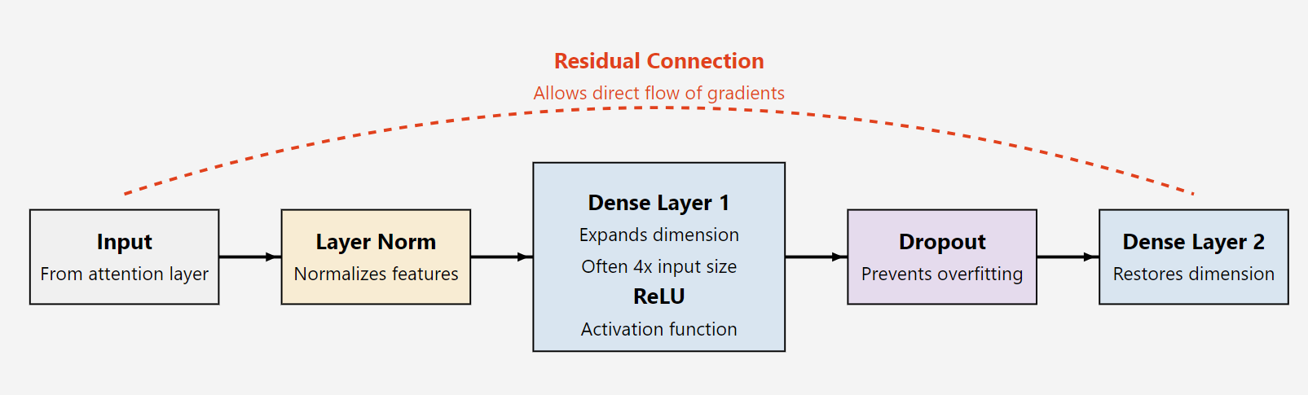
Feedforward architecture
Notes:
Input: This represents the input to the feedforward network, typically the output from the multi-head attention mechanism in a transformer layer.
Layer Norm: A layer normalization step, which normalizes the input across the feature dimension. This helps in stabilizing the learning process.
Dense Layer 1: The first fully connected layer. In transformers, this layer usually expands the dimensionality of the input, often by a factor of 4. It's followed by a ReLU (Rectified Linear Unit) activation function.
Dropout: A regularization technique that randomly sets a fraction of input units to 0 at each update during training, which helps prevent overfitting.
Dense Layer 2: The second dense layer, which projects the data back to the original dimensionality.
Residual Connection: This is shown by the dashed red line at the top. It allows the network to bypass the feedforward layers if necessary, which helps in training very deep networks.

Slide 26
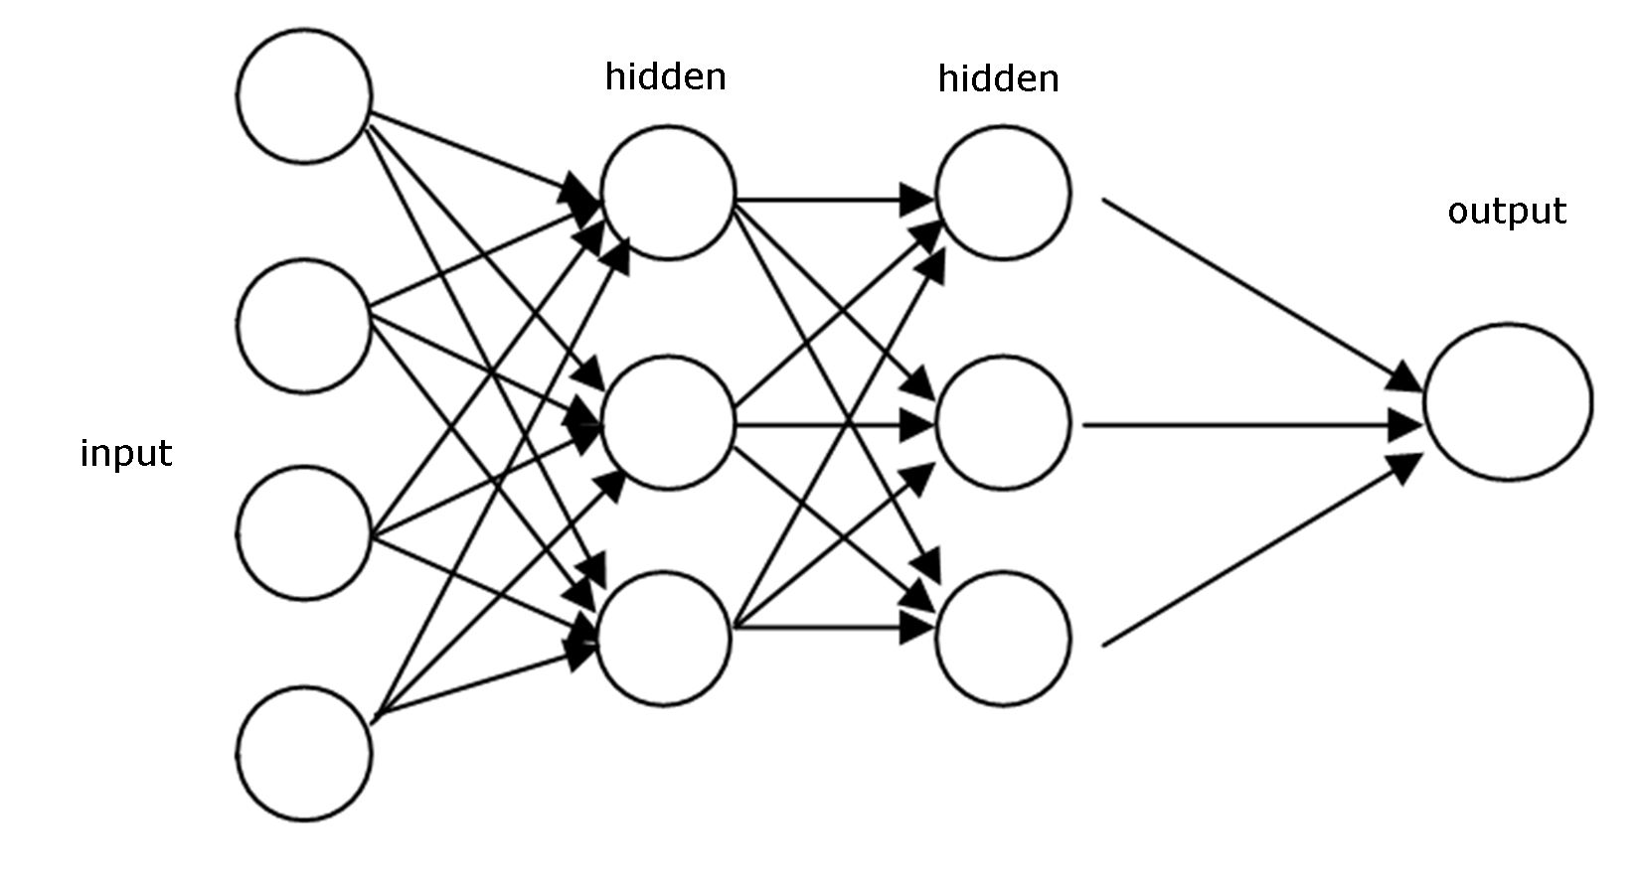

Slide 27
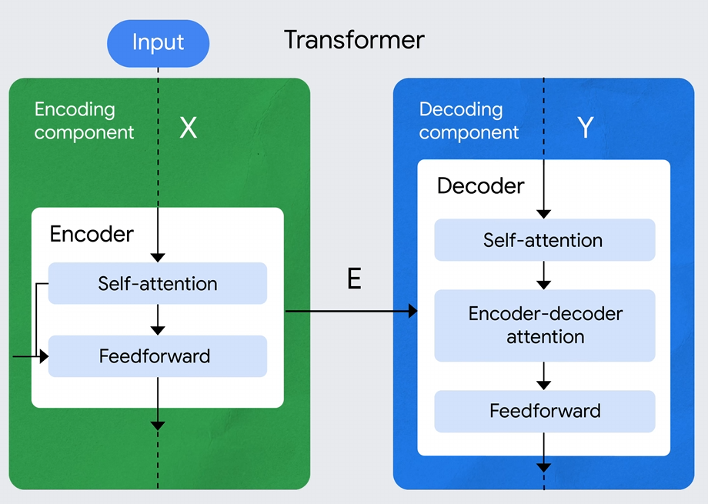
Notes:
Imagine translating a sentence from English to French:
Self-Attention in the Decoder: Helps the decoder understand how each French word relates to the previously translated French words.
Encoder-Decoder Attention: Helps the decoder understand which English words (or phrases) are relevant for translating the current French word.
Feedforward Layer: Takes the attended information and processes it to generate the final output in French.

Slide 28
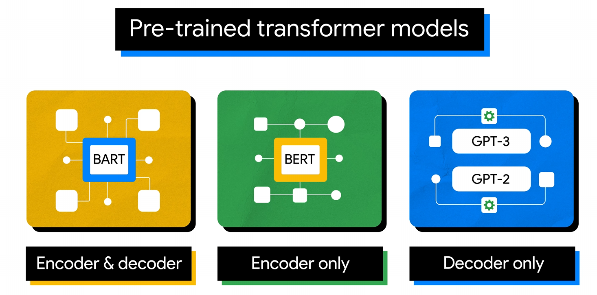

Slide 29
Transformer Variants: Bert (Encoder only)

Slide 30
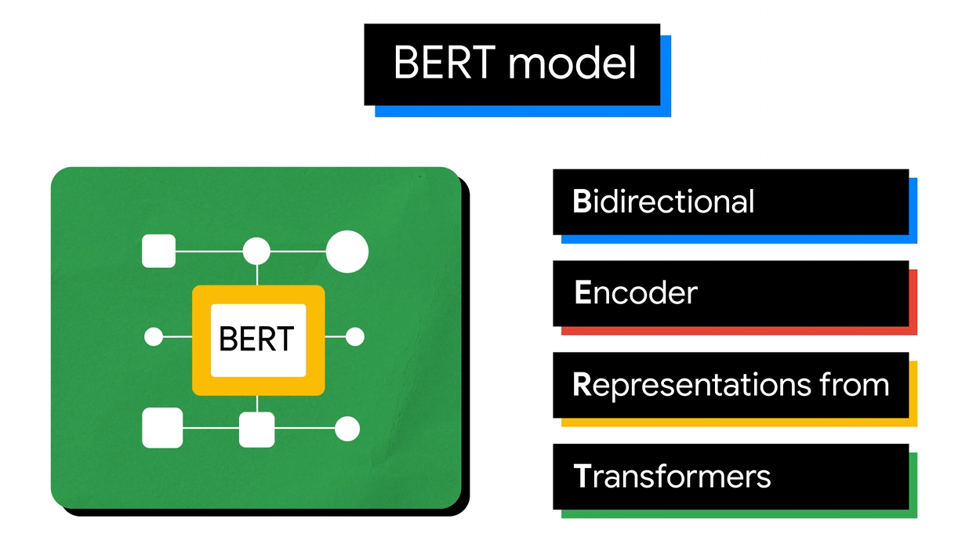

Slide 31
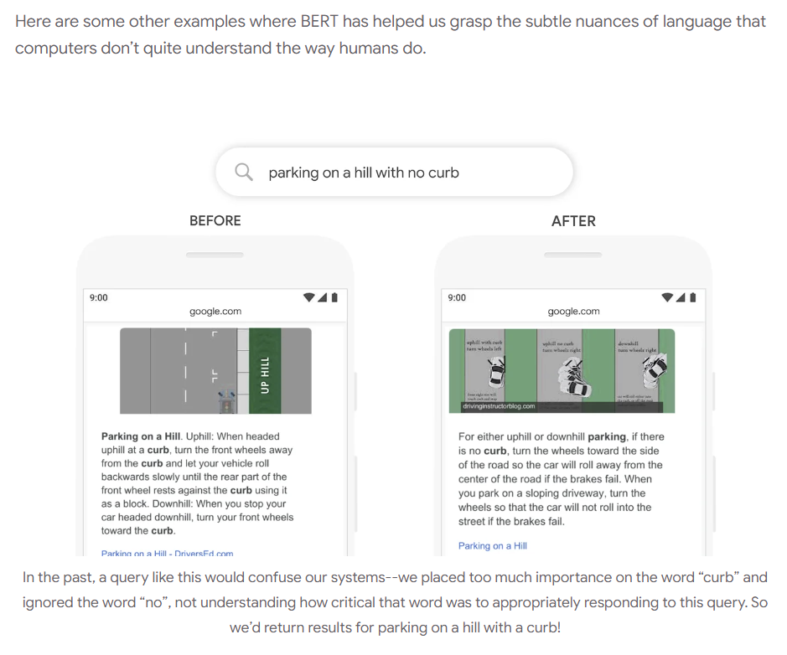
Notes:
https://blog.google/products/search/search-language-understanding-bert/

Slide 32
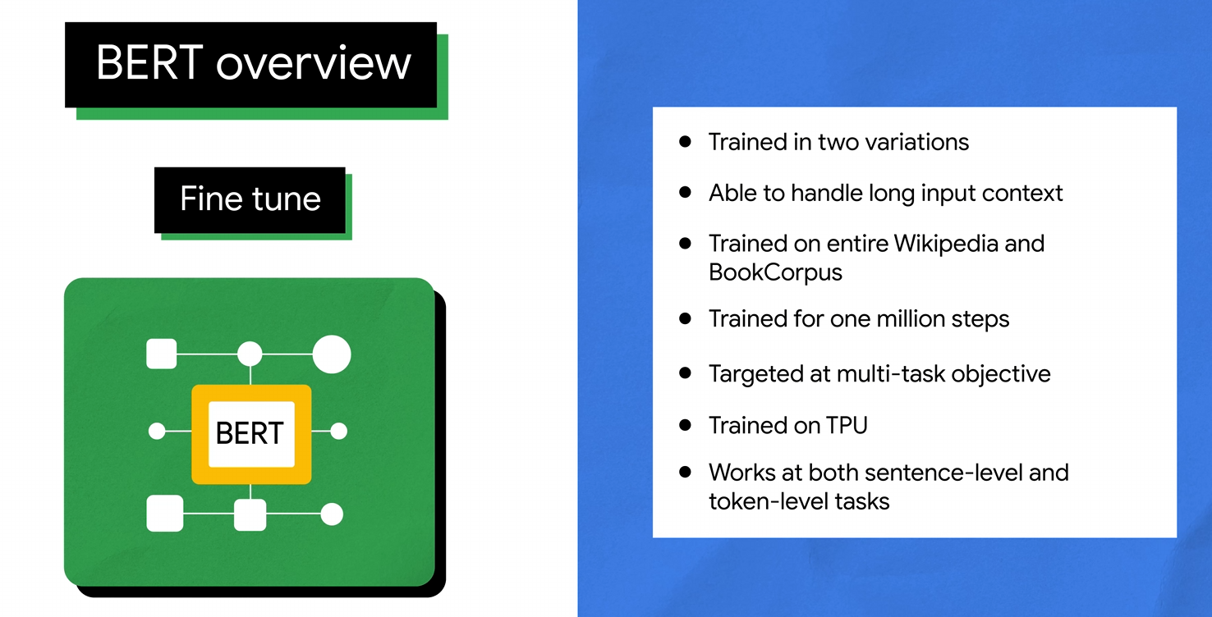

Slide 33
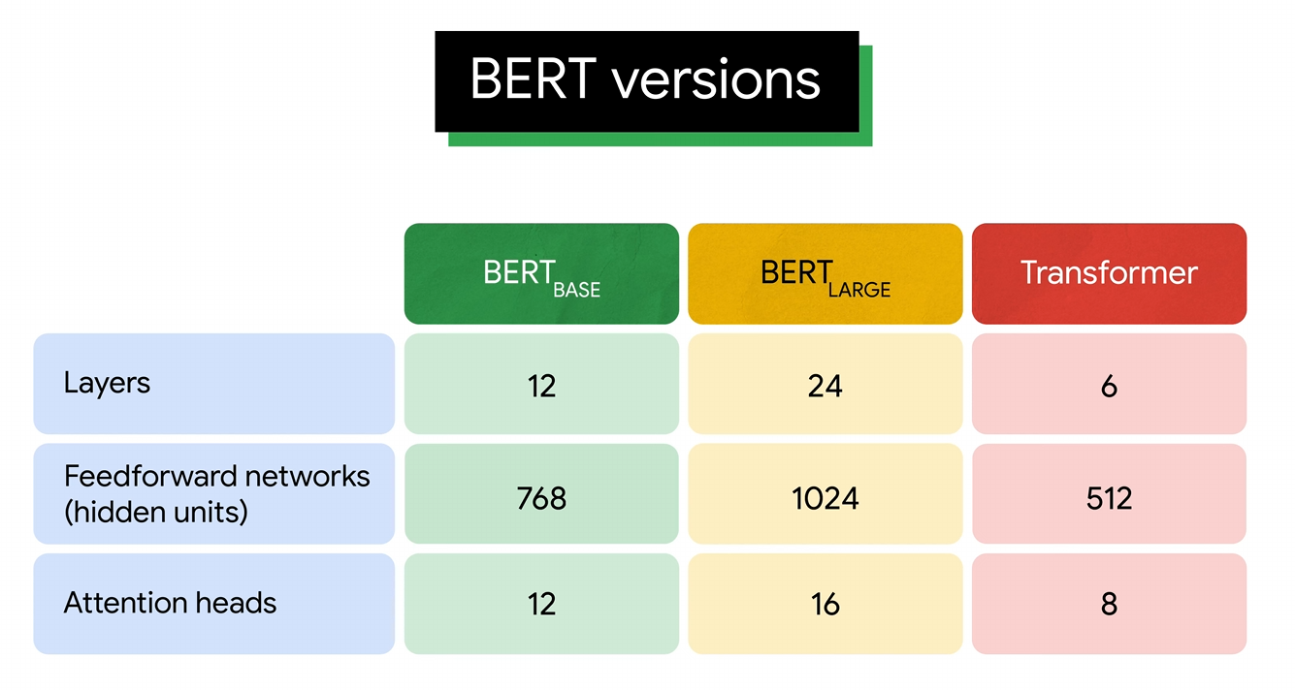

Slide 34
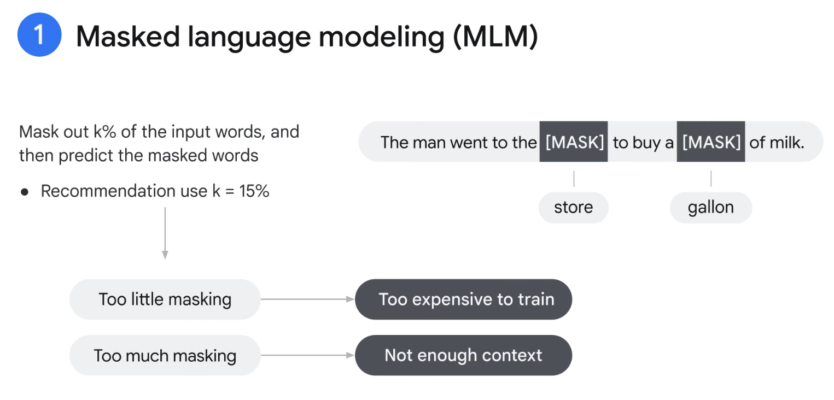

Slide 35
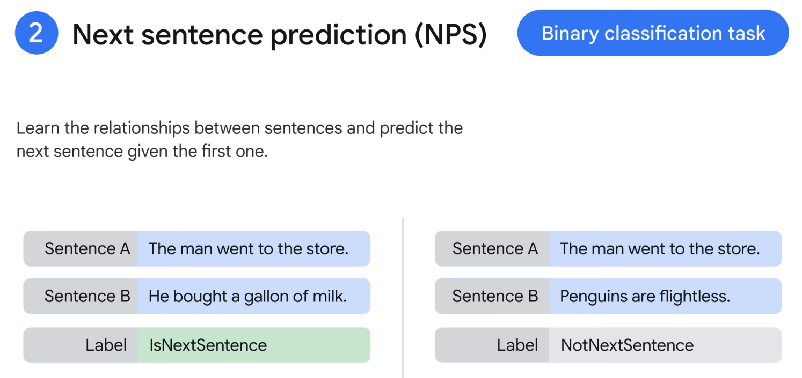

Slide 36
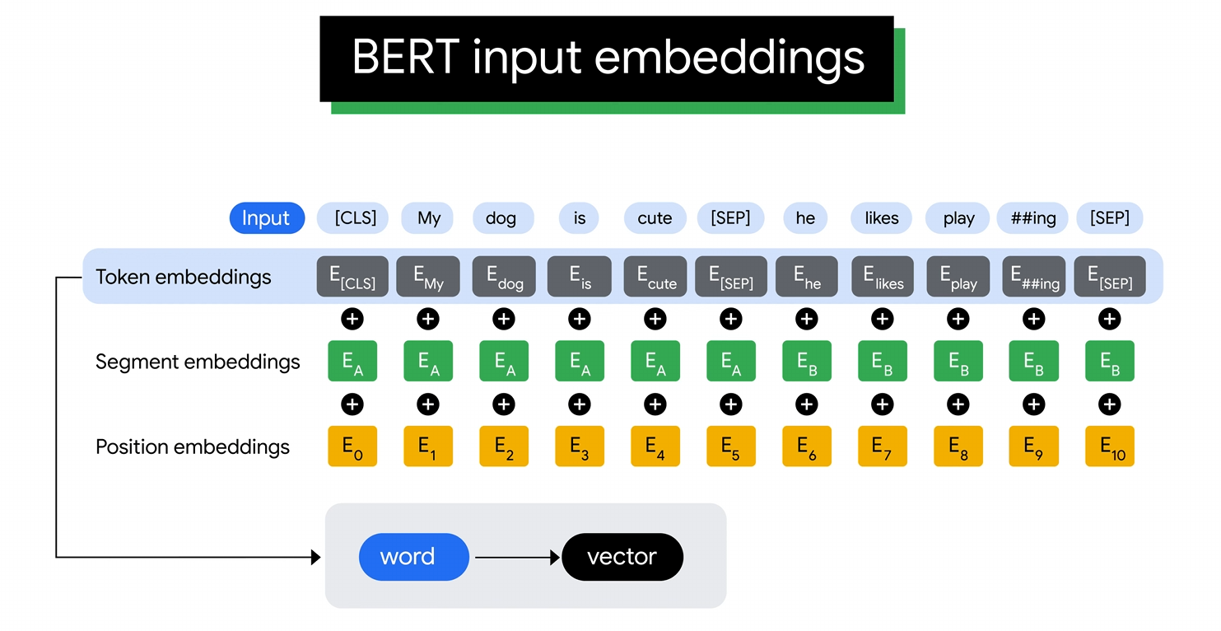

Slide 37
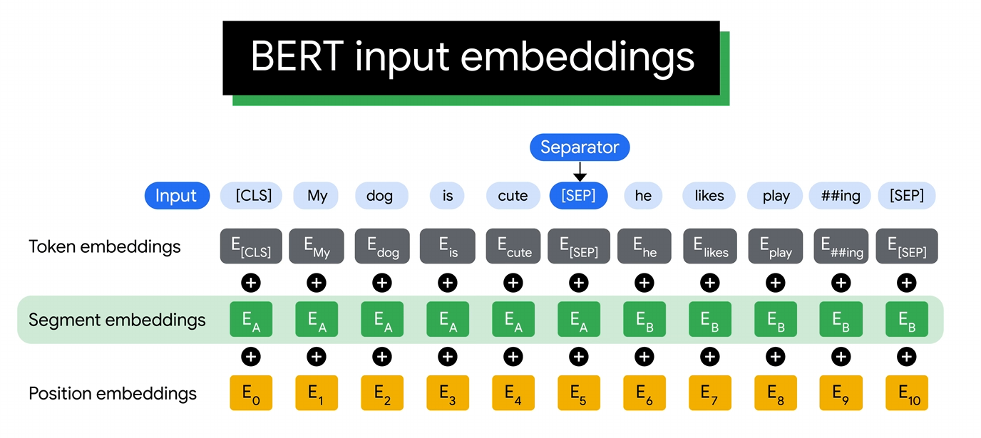

Slide 38
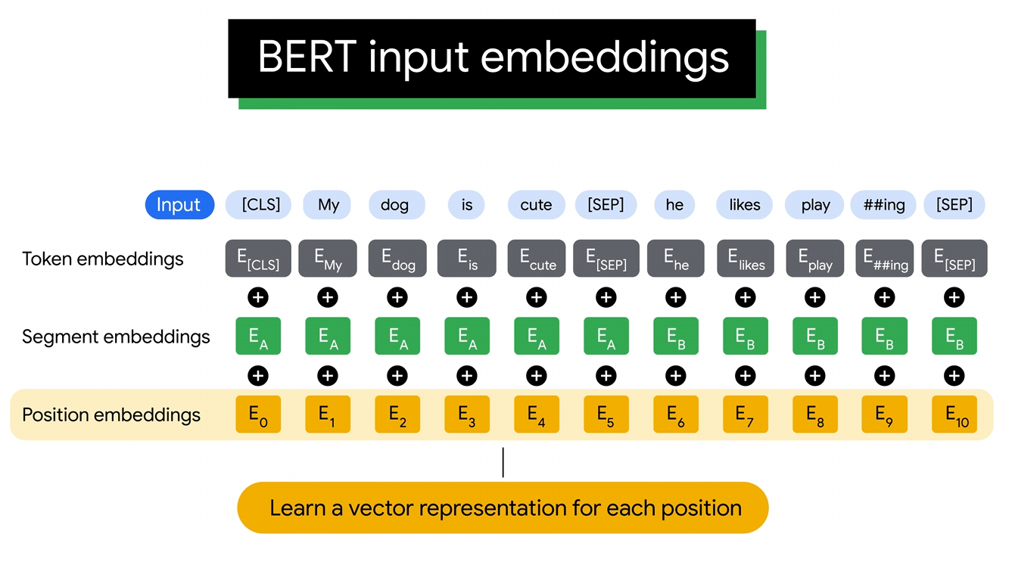

Slide 39
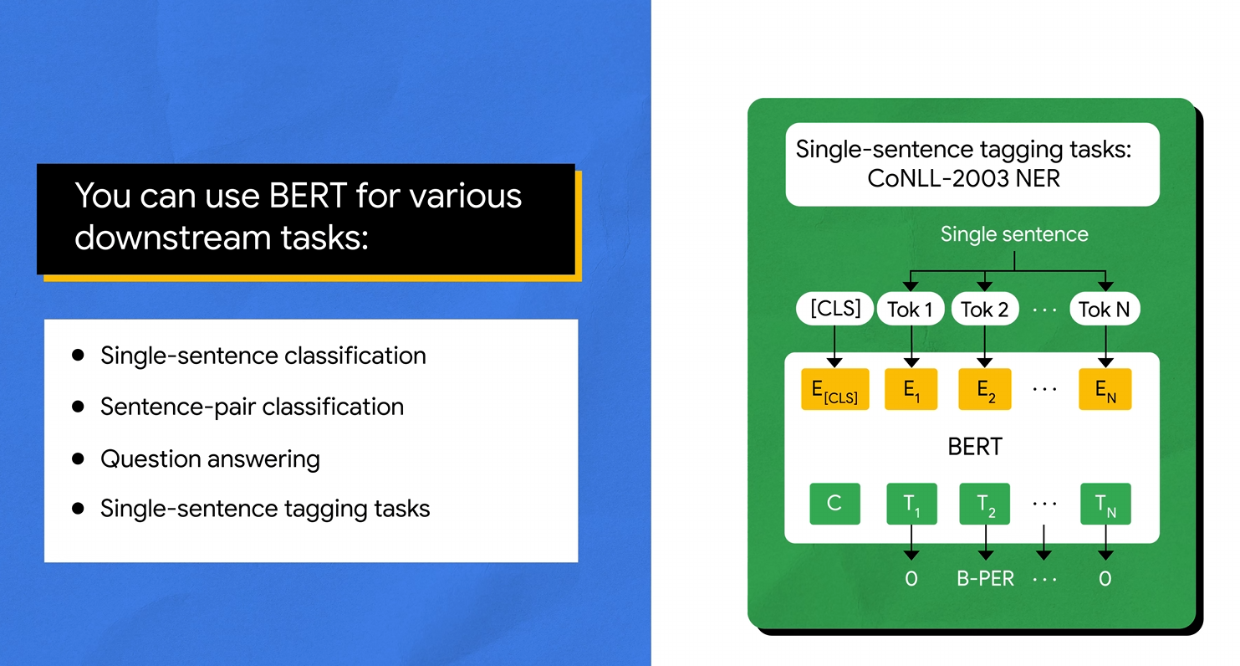

Slide 40


